Slide 1
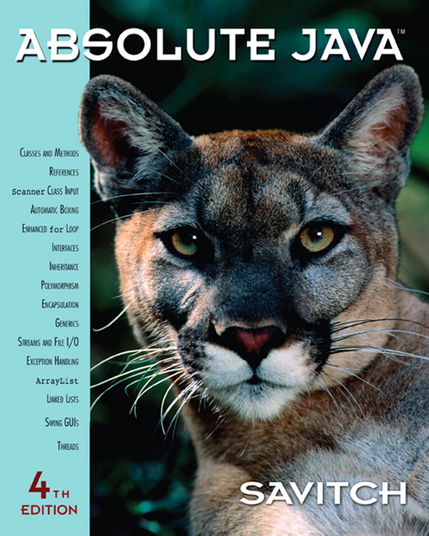

Chapter 1
Getting Started
Copyright © 2010 Pearson Addison-Wesley. All rights reserved.

Slide 2
Introduction To Java
Most people are familiar with Java as a language for Internet applications
We will study Java as a general purpose programming language
  The syntax of expressions and assignments will be similar to that of other high-level languages
  Details concerning the handling of strings and console output will probably be new
Copyright © 2010 Pearson Addison-Wesley. All rights reserved.
1-<number>

Slide 3
Origins of the Java Language
Created by Sun Microsystems team led by James Gosling (1991)
Originally designed for programming home appliances
  Difficult task because appliances are controlled by a wide variety of computer processors
  Team developed a two-step translation process to simplify the task of compiler writing for each class of appliances
Copyright © 2010 Pearson Addison-Wesley. All rights reserved.
1-<number>

Slide 4
Origins of the Java Language
Significance of Java translation process
  Writing a compiler (translation program) for each type of appliance processor would have been very costly
  Instead, developed intermediate language that is the same for all types of processors : Java byte-code
  Therefore, only a small, easy to write program was needed to translate byte-code into the machine code for each processor
Copyright © 2010 Pearson Addison-Wesley. All rights reserved.
1-<number>

Slide 5
Origins of the Java Language
Patrick Naughton and Jonathan Payne at Sun Microsystems developed a Web browser that could run programs over the Internet (1994)
  Beginning of Java's connection to the Internet
  Original browser evolves into HotJava
Netscape Incorporated made its Web browser capable of running Java programs (1995)
  Other companies follow suit
Copyright © 2010 Pearson Addison-Wesley. All rights reserved.
1-<number>

Slide 6
Objects and Methods
Java is an object-oriented programming (OOP) language
  Programming methodology that views a program as consisting of objects that interact with one another by means of actions (called methods)
  Objects of the same kind are said to have the same type or be in the same class
Copyright © 2010 Pearson Addison-Wesley. All rights reserved.
1-<number>

Slide 7
Terminology Comparisons
Other high-level languages have constructs called procedures, methods, functions, and/or subprograms
  These types of constructs are called methods in Java
  All programming constructs in Java, including methods, are part of a class
Copyright © 2010 Pearson Addison-Wesley. All rights reserved.
1-<number>

Slide 8
Java Application Programs
There are two types of Java programs: applications and applets
A Java application program or "regular" Java program is a class with a method named main
  When a Java application program is run, the run-time system automatically invokes the method named main
  All Java application programs start with the main method
Copyright © 2010 Pearson Addison-Wesley. All rights reserved.
1-<number>

Slide 9
Applets
A Java applet (little Java application) is a Java program that is meant to be run from a Web browser
  Can be run from a location on the Internet
  Can also be run with an applet viewer program for debugging
  Applets always use a windowing interface
In contrast, application programs may use a windowing interface or console (i.e., text) I/O
Copyright © 2010 Pearson Addison-Wesley. All rights reserved.
1-<number>

Slide 10
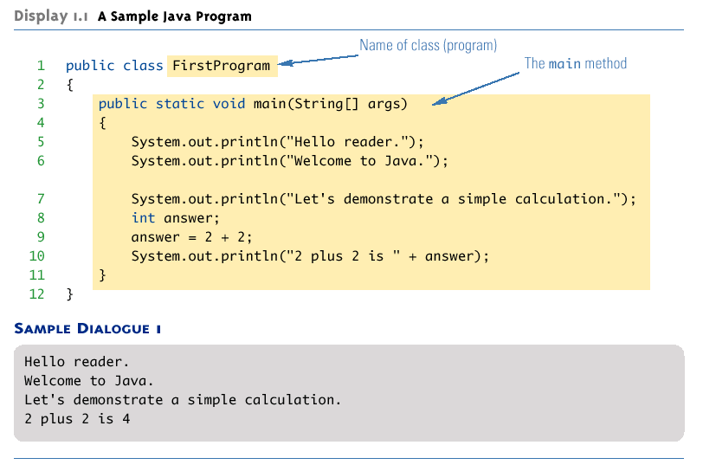
A Sample Java Application Program
Copyright © 2010 Pearson Addison-Wesley. All rights reserved.
1-<number>

Slide 11
System.out.println
Java programs work by having things called objects perform actions
  System.out: an object used for sending output to the screen
The actions performed by an object are called methods
  println: the method or action that the System.out object performs
Copyright © 2010 Pearson Addison-Wesley. All rights reserved.
1-<number>

Slide 12
System.out.println
Invoking or calling a method: When an object performs an action using a method
  Also called sending a message to the object
  Method invocation syntax (in order): an object, a dot (period), the method name, and a pair of parentheses
  Arguments: Zero or more pieces of information needed by the method that are placed inside the parentheses
System.out.println("This is an argument");
Copyright © 2010 Pearson Addison-Wesley. All rights reserved.
1-<number>

Slide 13
Variable declarations
Variable declarations in Java are similar to those in other programming languages
  Simply give the type of the variable followed by its name and a semicolon
int answer;
Copyright © 2010 Pearson Addison-Wesley. All rights reserved.
1-<number>

Slide 14
Using = and +
In Java, the equal sign (=) is used as the assignment operator
  The variable on the left side of the assignment operator is assigned the value of the expression on the right side of the assignment operator
  answer = 2 + 2;
In Java, the plus sign (+) can be used to denote addition (as above) or concatenation
  Using +, two strings can be connected together
System.out.println("2 plus 2 is " + answer);
Copyright © 2010 Pearson Addison-Wesley. All rights reserved.
1-<number>

Slide 15
Computer Language Levels
High-level language: A language that people can read, write, and understand
  A program written in a high-level language must be translated into a language that can be understood by a computer before it can be run
Machine language: A language that a computer can understand
Low-level language: Machine language or any language similar to machine language
Compiler: A program that translates a high-level language program into an equivalent low-level language program
  This translation process is called compiling
Copyright © 2010 Pearson Addison-Wesley. All rights reserved.
1-<number>

Slide 16
Byte-Code and the Java Virtual Machine
The compilers for most programming languages translate high-level programs directly into the machine language for a particular computer
  Since different computers have different machine languages, a different compiler is needed for each one
In contrast, the Java compiler translates Java programs into byte-code, a machine language for a fictitious computer called the Java Virtual Machine
  Once compiled to byte-code, a Java program can be used on any computer, making it very portable
Copyright © 2010 Pearson Addison-Wesley. All rights reserved.
1-<number>

Slide 17
Byte-Code and the Java Virtual Machine
Interpreter: The program that translates a program written in Java byte-code into the machine language for a particular computer when a Java program is executed
  The interpreter translates and immediately executes each byte-code instruction, one after another
  Translating byte-code into machine code is relatively easy compared to the initial compilation step
Copyright © 2010 Pearson Addison-Wesley. All rights reserved.
1-<number>

Slide 18
Program terminology
Code: A program or a part of a program
Source code (or source program): A program written in a high-level language such as Java
  The input to the compiler program
Object code: The translated low-level program
  The output from the compiler program, e.g., Java byte-code
  In the case of Java byte-code, the input to the Java byte-code interpreter
Copyright © 2010 Pearson Addison-Wesley. All rights reserved.
1-<number>

Slide 19
Class Loader
Java programs are divided into smaller parts called classes
  Each class definition is normally in a separate file and compiled separately
Class Loader: A program that connects the byte-code of the classes needed to run a Java program
  In other programming languages, the corresponding program is called a linker
Copyright © 2010 Pearson Addison-Wesley. All rights reserved.
1-<number>

Slide 20
Compiling a Java Program or Class
Each class definition must be in a file whose name is the same as the class name followed by .java
  The class FirstProgram must be in a file named FirstProgram.java
Each class is compiled with the command javac followed by the name of the file in which the class resides
  javac FirstProgram.java
  The result is a byte-code program whose filename is the same as the class name followed by .class
  FirstProgram.class
Copyright © 2010 Pearson Addison-Wesley. All rights reserved.
1-<number>

Slide 21
Running a Java Program
A Java program can be given the run command (java) after all its classes have been compiled
  Only run the class that contains the main method (the system will automatically load and run the other classes, if any)
  The main method begins with the line:
  public static void main(String[ ] args)
  Follow the run command by the name of the class only (no .java or .class extension)
  java FirstProgram
Copyright © 2010 Pearson Addison-Wesley. All rights reserved.
1-<number>

Slide 22
Syntax and Semantics
Syntax: The arrangement of words and punctuations that are legal in a language, the grammar rules of a language
Semantics: The meaning of things written while following the syntax rules of a language
Copyright © 2010 Pearson Addison-Wesley. All rights reserved.
1-<number>

Slide 23
Tip: Error Messages
Bug: A mistake in a program
  The process of eliminating bugs is called debugging
Syntax error: A grammatical mistake in a program
  The compiler can detect these errors, and will output an error message saying what it thinks the error is, and where it thinks the error is
Copyright © 2010 Pearson Addison-Wesley. All rights reserved.
1-<number>

Slide 24
Tip: Error Messages
Run-time error: An error that is not detected until a program is run
  The compiler cannot detect these errors: an error message is not generated after compilation, but after execution
Logic error: A mistake in the underlying algorithm for a program
  The compiler cannot detect these errors, and no error message is generated after compilation or execution, but the program does not do what it is supposed to do
Copyright © 2010 Pearson Addison-Wesley. All rights reserved.
1-<number>

Slide 25
Identifiers
Identifier: The name of a variable or other item (class, method, object, etc.) defined in a program
  A Java identifier must not start with a digit, and all the characters must be letters, digits, or the underscore symbol
  Java identifiers can theoretically be of any length
  Java is a case-sensitive language: Rate, rate, and RATE are the names of three different variables
Copyright © 2010 Pearson Addison-Wesley. All rights reserved.
1-<number>

Slide 26
Identifiers
Keywords and Reserved words: Identifiers that have a predefined meaning in Java
  Do not use them to name anything else
  public class void static
Predefined identifiers: Identifiers that are defined in libraries required by the Java language standard
  Although they can be redefined, this could be confusing and dangerous if doing so would change their standard meaning
  System String println
Copyright © 2010 Pearson Addison-Wesley. All rights reserved.
1-<number>

Slide 27
Naming Conventions
Start the names of variables, classes, methods, and objects with a lowercase letter, indicate "word" boundaries with an uppercase letter, and restrict the remaining characters to digits and lowercase letters
  topSpeed bankRate1 timeOfArrival
Start the names of classes with an uppercase letter and, otherwise, adhere to the rules above
  FirstProgram MyClass String
Copyright © 2010 Pearson Addison-Wesley. All rights reserved.
1-<number>

Slide 28
Variable Declarations
Every variable in a Java program must be declared before it is used
  A variable declaration tells the compiler what kind of data (type) will be stored in the variable
  The type of the variable is followed by one or more variable names separated by commas, and terminated with a semicolon
  Variables are typically declared just before they are used or at the start of a block (indicated by an opening brace { )
  Basic types in Java are called primitive types
    int numberOfBeans;
    double oneWeight, totalWeight;
Copyright © 2010 Pearson Addison-Wesley. All rights reserved.
1-<number>

Slide 29
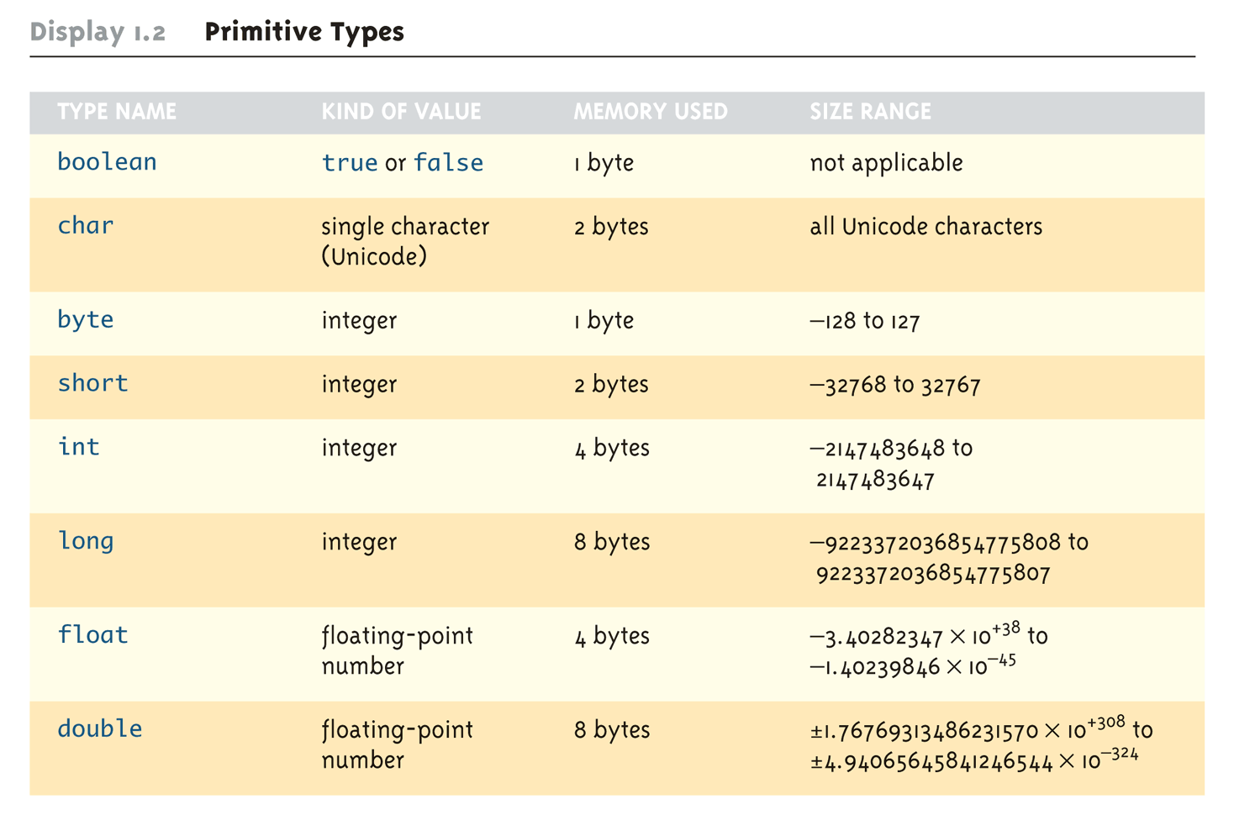
Primitive Types
Copyright © 2010 Pearson Addison-Wesley. All rights reserved.
1-<number>

Slide 30
Assignment Statements With Primitive Types
In Java, the assignment statement is used to change the value of a variable
  The equal sign (=) is used as the assignment operator
  An assignment statement consists of a variable on the left side of the operator, and an expression on the right side of the operator
    Variable = Expression;
  An expression consists of a variable, number, or mix of variables, numbers, operators, and/or method invocations
  temperature = 98.6;
  count = numberOfBeans;
Copyright © 2010 Pearson Addison-Wesley. All rights reserved.
1-<number>

Slide 31
Assignment Statements With Primitive Types
  When an assignment statement is executed, the expression is first evaluated, and then the variable on the left-hand side of the equal sign is set equal to the value of the expression
  distance = rate * time;
  Note that a variable can occur on both sides of the assignment operator
  count = count + 2;
  The assignment operator is automatically executed from right-to-left, so assignment statements can be chained
  number2 = number1 = 3;
Copyright © 2010 Pearson Addison-Wesley. All rights reserved.
1-<number>

Slide 32
Tip: Initialize Variables
A variable that has been declared but that has not yet been given a value by some means is said to be uninitialized
In certain cases an uninitialized variable is given a default value
  It is best not to rely on this
  Explicitly initialized variables have the added benefit of improving program clarity
Copyright © 2010 Pearson Addison-Wesley. All rights reserved.
1-<number>

Slide 33
Tip: Initialize Variables
The declaration of a variable can be combined with its initialization via an assignment statement
    int count = 0;
    double distance = 55 * .5;
    char grade = 'A';
  Note that some variables can be initialized and others can remain uninitialized in the same declaration
  int initialCount = 50, finalCount;
Copyright © 2010 Pearson Addison-Wesley. All rights reserved.
1-<number>

Slide 34
Shorthand Assignment Statements
Shorthand assignment notation combines the assignment operator (=) and an arithmetic operator
It is used to change the value of a variable by adding, subtracting, multiplying, or dividing by a specified value
The general form is
  Variable Op = Expression
  which is equivalent to
  Variable = Variable Op (Expression)
  The Expression can be another variable, a constant, or a more complicated expression
  Some examples of what Op can be are +, -, *, /, or %
Copyright © 2010 Pearson Addison-Wesley. All rights reserved.
1-<number>

Slide 35
Shorthand Assignment Statements
Example: | Equivalent To:
count += 2; | count = count + 2;
sum -= discount; | sum = sum – discount;
bonus *= 2; | bonus = bonus * 2;
time /= rushFactor; | time = time / rushFactor;
change %= 100; | change = change % 100;
amount *= count1 + count2; | amount = amount * (count1 + count2);
Copyright © 2010 Pearson Addison-Wesley. All rights reserved.
1-<number>

Slide 36
Assignment Compatibility
In general, the value of one type cannot be stored in a variable of another type
  int intVariable = 2.99; //Illegal
  The above example results in a type mismatch because a double value cannot be stored in an int variable
However, there are exceptions to this
  double doubleVariable = 2;
  For example, an int value can be stored in a double type
Copyright © 2010 Pearson Addison-Wesley. All rights reserved.
1-<number>

Slide 37
Assignment Compatibility
More generally, a value of any type in the following list can be assigned to a variable of any type that appears to the right of it
  byte→short→int→long→float→double
  char
  Note that as your move down the list from left to right, the range of allowed values for the types becomes larger
An explicit type cast is required to assign a value of one type to a variable whose type appears to the left of it on the above list (e.g., double to int)
Note that in Java an int cannot be assigned to a variable of type boolean, nor can a boolean be assigned to a variable of type int
Copyright © 2010 Pearson Addison-Wesley. All rights reserved.
1-<number>

Slide 38
Constants
Constant (or literal): An item in Java which has one specific value that cannot change
  Constants of an integer type may not be written with a decimal point (e.g., 10)
  Constants of a floating-point type can be written in ordinary decimal fraction form (e.g., 367000.0 or 0.000589)
  Constant of a floating-point type can also be written in scientific (or floating-point) notation (e.g., 3.67e5 or 5.89e-4)
    Note that the number before the e may contain a decimal point, but the number after the e may not
Copyright © 2010 Pearson Addison-Wesley. All rights reserved.
1-<number>

Slide 39
Constants
Constants of type char are expressed by placing a single character in single quotes (e.g., 'Z')
Constants for strings of characters are enclosed by double quotes (e.g., "Welcome to Java")
There are only two boolean type constants, true and false
  Note that they must be spelled with all lowercase letters
Copyright © 2010 Pearson Addison-Wesley. All rights reserved.
1-<number>

Slide 40
Arithmetic Operators and Expressions
As in most languages, expressions can be formed in Java using variables, constants, and arithmetic operators
  These operators are + (addition), - (subtraction), * (multiplication), / (division), and % (modulo, remainder)
  An expression can be used anyplace it is legal to use a value of the type produced by the expression
Copyright © 2010 Pearson Addison-Wesley. All rights reserved.
1-<number>

Slide 41
Arithmetic Operators and Expressions
If an arithmetic operator is combined with int operands, then the resulting type is int
If an arithmetic operator is combined with one or two double operands, then the resulting type is double
If different types are combined in an expression, then the resulting type is the right-most type on the following list that is found within the expression
  byte→short→int→long→float→double
  char
  Exception: If the type produced should be byte or short (according to the rules above), then the type produced will actually be an int
Copyright © 2010 Pearson Addison-Wesley. All rights reserved.
1-<number>

Slide 42
Parentheses and Precedence Rules
An expression can be fully parenthesized in order to specify exactly what subexpressions are combined with each operator
If some or all of the parentheses in an expression are omitted, Java will follow precedence rules to determine, in effect, where to place them
  However, it's best (and sometimes necessary) to include them
Copyright © 2010 Pearson Addison-Wesley. All rights reserved.
1-<number>

Slide 43
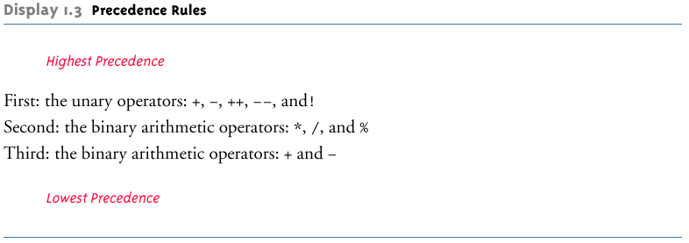
Precedence Rules
Copyright © 2010 Pearson Addison-Wesley. All rights reserved.
1-<number>

Slide 44
Precedence and Associativity Rules
When the order of two adjacent operations must be determined, the operation of higher precedence (and its apparent arguments) is grouped before the operation of lower precedence
    base + rate * hours is evaluated as
    base + (rate * hours)
When two operations have equal precedence, the order of operations is determined by associativity rules
Copyright © 2010 Pearson Addison-Wesley. All rights reserved.
1-<number>

Slide 45
Precedence and Associativity Rules
  Unary operators of equal precedence are grouped right-to-left
    +-+rate is evaluated as +(-(+rate))
  Binary operators of equal precedence are grouped left-to-right
    base + rate + hours is evaluated as
    (base + rate) + hours
  Exception: A string of assignment operators is grouped right-to-left
    n1 = n2 = n3; is evaluated as n1 = (n2 = n3);
Copyright © 2010 Pearson Addison-Wesley. All rights reserved.
1-<number>

Slide 46
Pitfall: Round-Off Errors in Floating-Point Numbers
Floating point numbers are only approximate quantities
  Mathematically, the floating-point number 1.0/3.0 is equal to 0.3333333 . . .
  A computer has a finite amount of storage space
    It may store 1.0/3.0 as something like 0.3333333333, which is slightly smaller than one-third
  Computers actually store numbers in binary notation, but the consequences are the same: floating-point numbers may lose accuracy
Copyright © 2010 Pearson Addison-Wesley. All rights reserved.
1-<number>

Slide 47
Integer and Floating-Point Division
When one or both operands are a floating-point type, division results in a floating-point type
  15.0/2 evaluates to 7.5
When both operands are integer types, division results in an integer type
  Any fractional part is discarded
  The number is not rounded
    15/2 evaluates to 7
Be careful to make at least one of the operands a floating-point type if the fractional portion is needed
Copyright © 2010 Pearson Addison-Wesley. All rights reserved.
1-<number>

Slide 48
The % Operator
The % operator is used with operands of type int to recover the information lost after performing integer division
  15/2 evaluates to the quotient 7
  15%2 evaluates to the remainder 1
The % operator can be used to count by 2's, 3's, or any other number
  To count by twos, perform the operation number % 2, and when the result is 0, number is even
Copyright © 2010 Pearson Addison-Wesley. All rights reserved.
1-<number>

Slide 49
Type Casting
A type cast takes a value of one type and produces a value of another type with an "equivalent" value
  If n and m are integers to be divided, and the fractional portion of the result must be preserved, at least one of the two must be type cast to a floating-point type before the division operation is performed
    double ans = n / (double)m;
  Note that the desired type is placed inside parentheses immediately in front of the variable to be cast
  Note also that the type and value of the variable to be cast does not change
Copyright © 2010 Pearson Addison-Wesley. All rights reserved.
1-<number>

Slide 50
More Details About Type Casting
When type casting from a floating-point to an integer type, the number is truncated, not rounded
  (int)2.9 evaluates to 2, not 3
When the value of an integer type is assigned to a variable of a floating-point type, Java performs an automatic type cast called a type coercion
    double d = 5;
In contrast, it is illegal to place a double value into an int variable without an explicit type cast
    int i = 5.5; // Illegal
    int i = (int)5.5 // Correct
Copyright © 2010 Pearson Addison-Wesley. All rights reserved.
1-<number>

Slide 51
Increment and Decrement Operators
The increment operator (++) adds one to the value of a variable
  If n is equal to 2, then n++ or ++n will change the value of n to 3
The decrement operator (--) subtracts one from the value of a variable
  If n is equal to 4, then n-- or --n will change the value of n to 3
Copyright © 2010 Pearson Addison-Wesley. All rights reserved.
1-<number>

Slide 52
Increment and Decrement Operators
When either operator precedes its variable, and is part of an expression, then the expression is evaluated using the changed value of the variable
  If n is equal to 2, then 2*(++n) evaluates to 6
When either operator follows its variable, and is part of an expression, then the expression is evaluated using the original value of the variable, and only then is the variable value changed
  If n is equal to 2, then 2*(n++) evaluates to 4
Copyright © 2010 Pearson Addison-Wesley. All rights reserved.
1-<number>

Slide 53
The Class String
There is no primitive type for strings in Java
The class String is a predefined class in Java that is used to store and process strings
Objects of type String are made up of strings of characters that are written within double quotes
  Any quoted string is a constant of type String
    "Live long and prosper."
A variable of type String can be given the value of a String object
  String blessing = "Live long and prosper.";
Copyright © 2010 Pearson Addison-Wesley. All rights reserved.
1-<number>

Slide 54
Concatenation of Strings
Concatenation: Using the + operator on two strings in order to connect them to form one longer string
  If greeting is equal to "Hello ", and javaClass is equal to "class", then greeting + javaClass is equal to "Hello class"
Any number of strings can be concatenated together
When a string is combined with almost any other type of item, the result is a string
  "The answer is " + 42 evaluates to
  "The answer is 42"
Copyright © 2010 Pearson Addison-Wesley. All rights reserved.
1-<number>

Slide 55
Classes, Objects, and Methods
A class is the name for a type whose values are objects
Objects are entities that store data and take actions
  Objects of the String class store data consisting of strings of characters
The actions that an object can take are called methods
  Methods can return a value of a single type and/or perform an action
  All objects within a class have the same methods, but each can have different data values
Copyright © 2010 Pearson Addison-Wesley. All rights reserved.
1-<number>

Slide 56
Classes, Objects, and Methods
Invoking or calling a method: a method is called into action by writing the name of the calling object, followed by a dot, followed by the method name, followed by parentheses
  This is sometimes referred to as sending a message to the object
  The parentheses contain the information (if any) needed by the method
  This information is called an argument (or arguments)
Copyright © 2010 Pearson Addison-Wesley. All rights reserved.
1-<number>

Slide 57
String Methods
The String class contains many useful methods for string-processing applications
  A String method is called by writing a String object, a dot, the name of the method, and a pair of parentheses to enclose any arguments
  If a String method returns a value, then it can be placed anywhere that a value of its type can be used
    String greeting = "Hello";
    int count = greeting.length();
    System.out.println("Length is " + greeting.length());
  Always count from zero when referring to the position or index of a character in a string
Copyright © 2010 Pearson Addison-Wesley. All rights reserved.
1-<number>

Slide 58
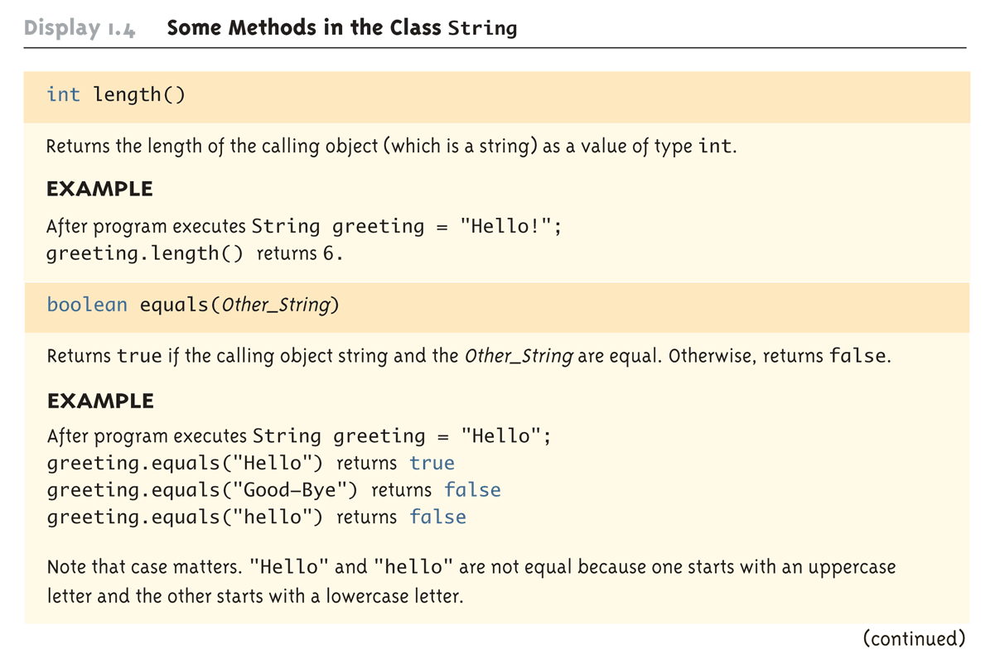
Some Methods in the Class String (Part 1 of 8)
Copyright © 2010 Pearson Addison-Wesley. All rights reserved.
1-<number>

Slide 59
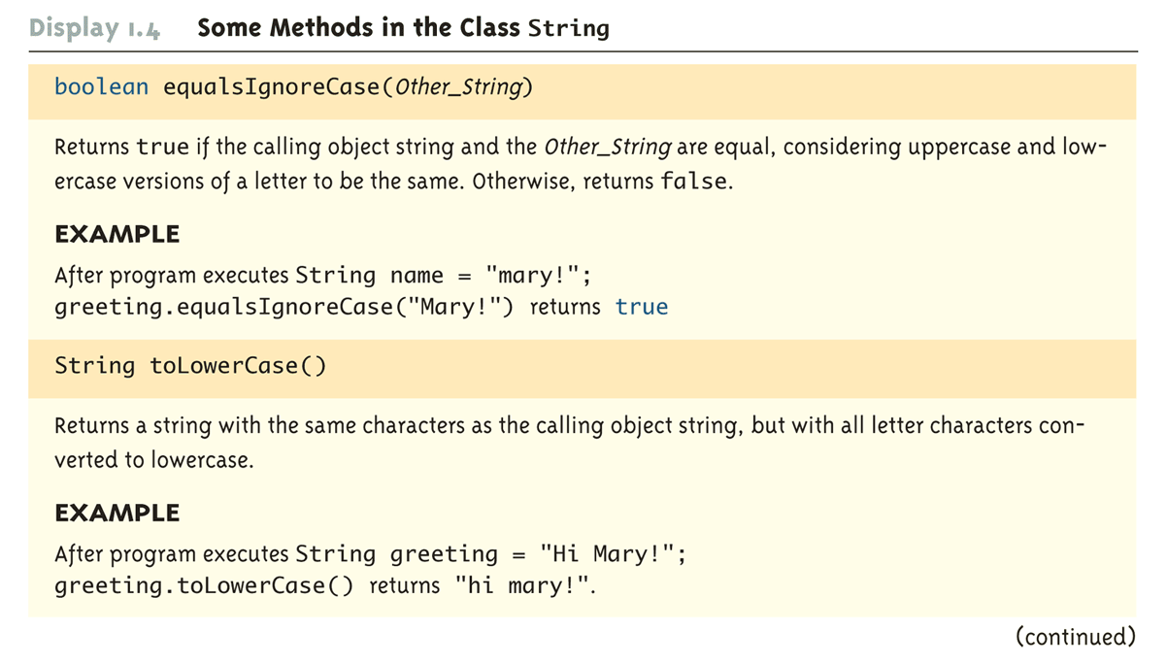
Some Methods in the Class String (Part 2 of 8)
Copyright © 2010 Pearson Addison-Wesley. All rights reserved.
1-<number>

Slide 60
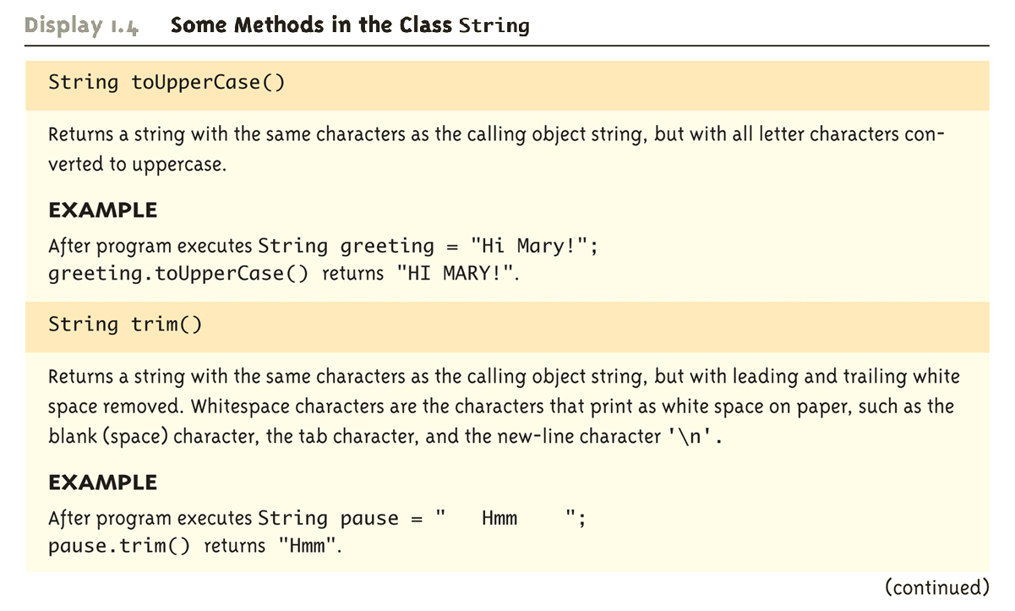
Some Methods in the Class String (Part 3 of 8)
Copyright © 2010 Pearson Addison-Wesley. All rights reserved.
1-<number>

Slide 61
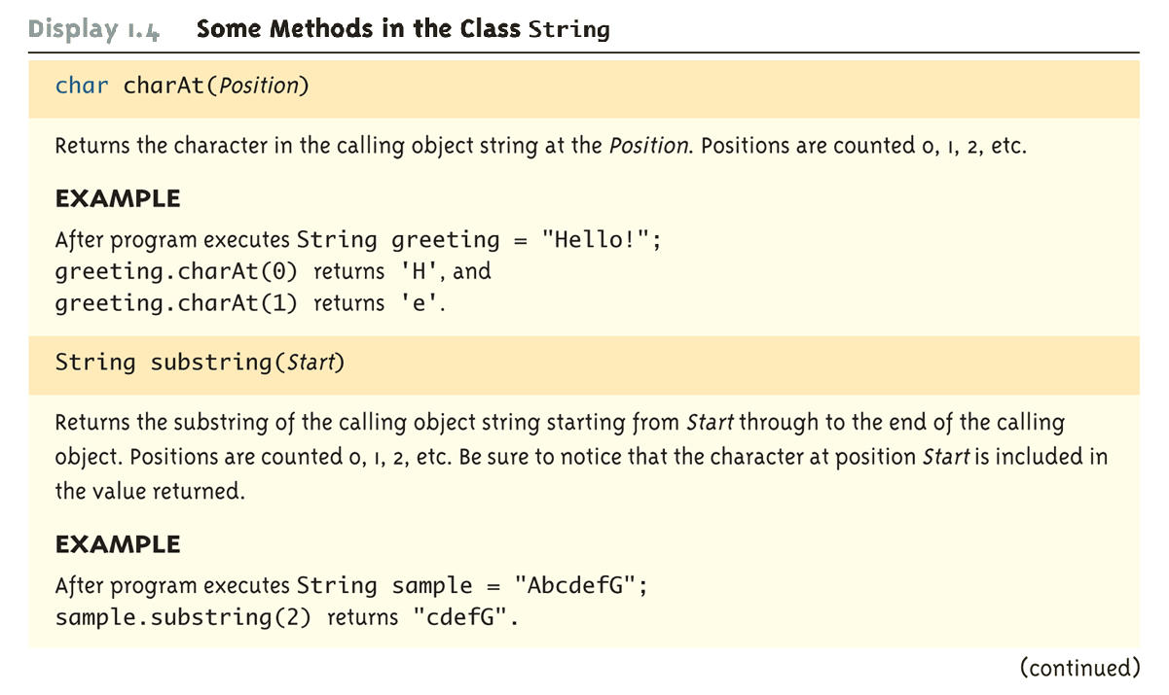
Some Methods in the Class String (Part 4 of 8)
Copyright © 2010 Pearson Addison-Wesley. All rights reserved.
1-<number>

Slide 62
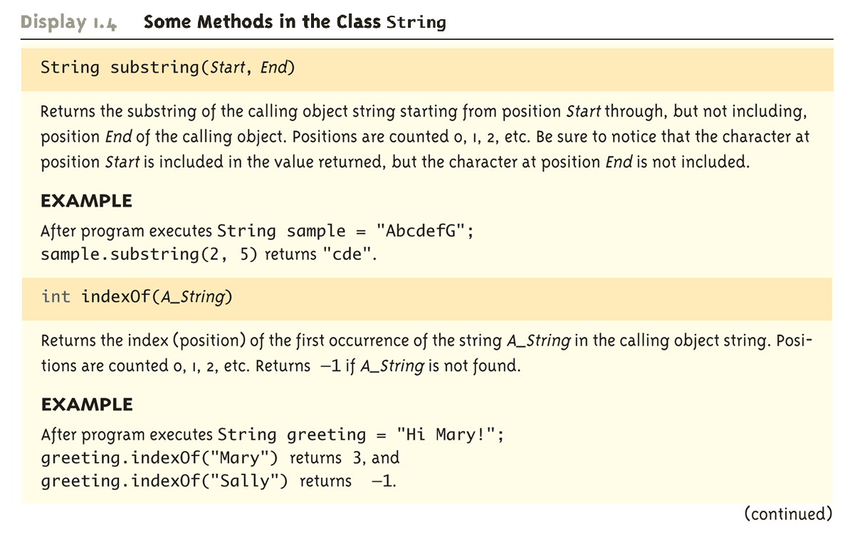
Some Methods in the Class String (Part 5 of 8)
Copyright © 2010 Pearson Addison-Wesley. All rights reserved.
1-<number>

Slide 63
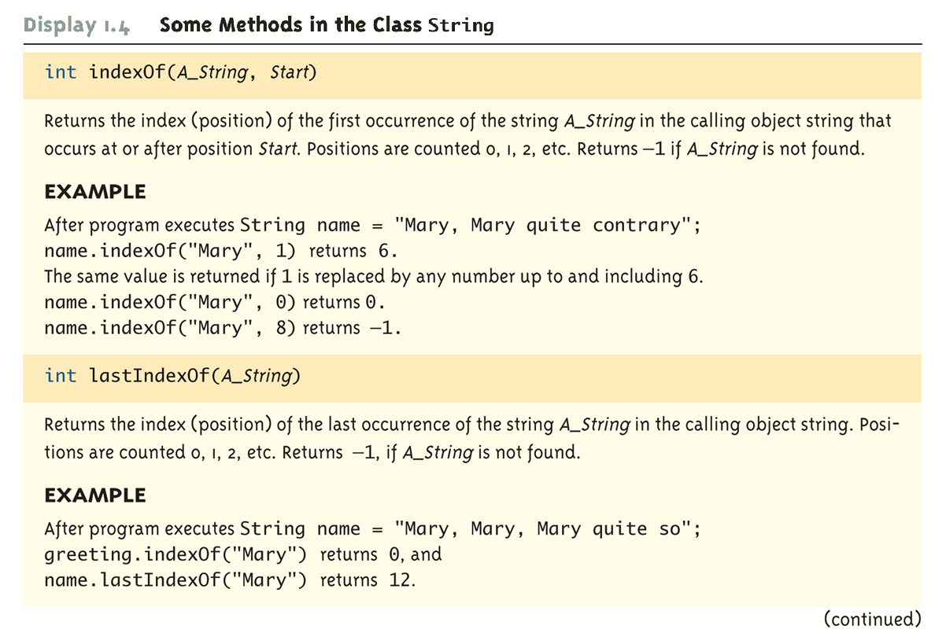
Some Methods in the Class String (Part 6 of 8)
Copyright © 2010 Pearson Addison-Wesley. All rights reserved.
1-<number>

Slide 64
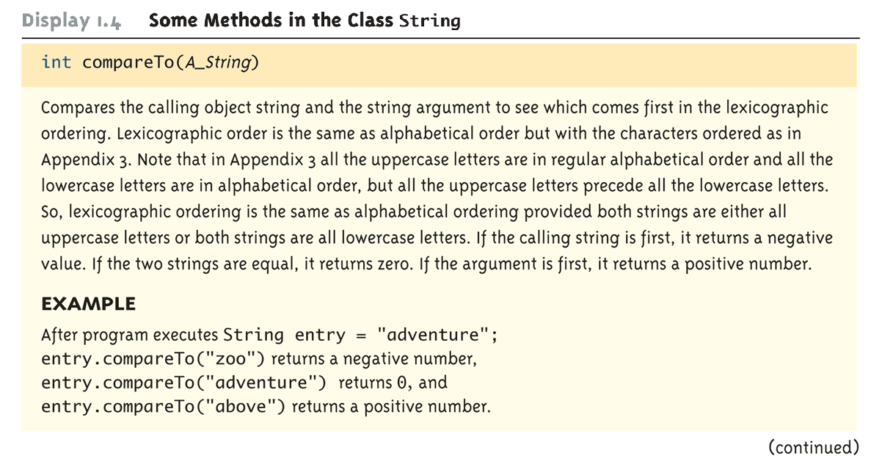
Some Methods in the Class String (Part 7 of 8)
Copyright © 2010 Pearson Addison-Wesley. All rights reserved.
1-<number>

Slide 65
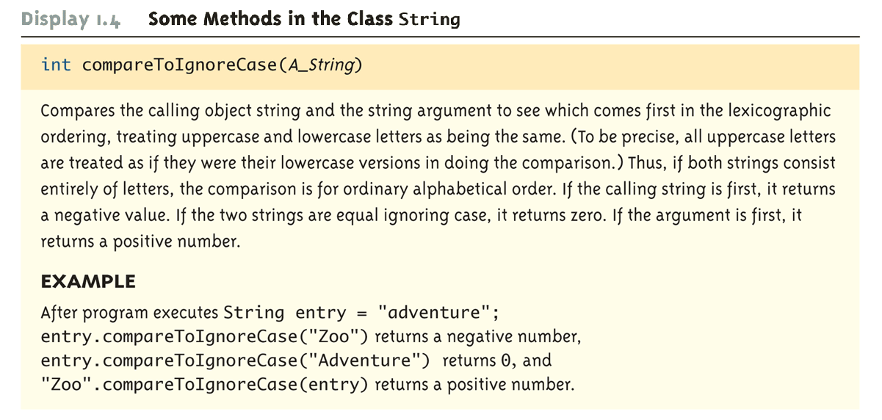
Some Methods in the Class String (Part 8 of 8)
Copyright © 2010 Pearson Addison-Wesley. All rights reserved.
1-<number>

Slide 66
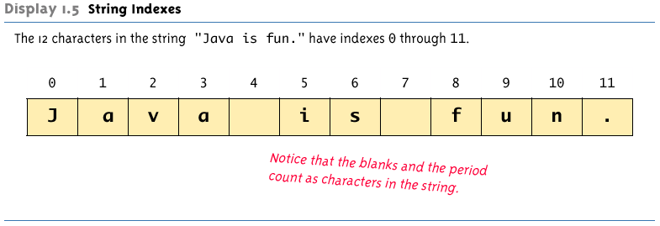
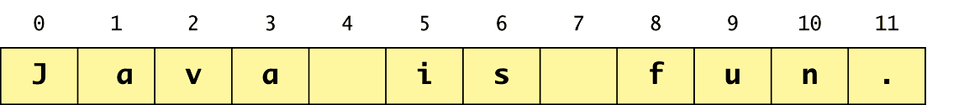
String Indexes
Copyright © 2010 Pearson Addison-Wesley. All rights reserved.
1-<number>

Slide 67
Escape Sequences
A backslash (\) immediately preceding a character (i.e., without any space) denotes an escape sequence or an escape character
  The character following the backslash does not have its usual meaning
  Although it is formed using two symbols, it is regarded as a single character
Copyright © 2010 Pearson Addison-Wesley. All rights reserved.
1-<number>

Slide 68
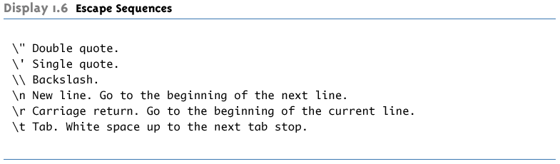
Escape Sequences
Copyright © 2010 Pearson Addison-Wesley. All rights reserved.
1-<number>

Slide 69
String Processing
A String object in Java is considered to be immutable, i.e., the characters it contains cannot be changed
There is another class in Java called StringBuffer that has methods for editing its string objects
However, it is possible to change the value of a String variable by using an assignment statement
    String name = "Soprano";
    name = "Anthony " + name;
Copyright © 2010 Pearson Addison-Wesley. All rights reserved.
1-<number>

Slide 70
Character Sets
ASCII: A character set used by many programming languages that contains all the characters normally used on an English-language keyboard, plus a few special characters
  Each character is represented by a particular number
Unicode: A character set used by the Java language that includes all the ASCII characters plus many of the characters used in languages with a different alphabet from English
Copyright © 2010 Pearson Addison-Wesley. All rights reserved.
1-<number>

Slide 71
Naming Constants
Instead of using "anonymous" numbers in a program, always declare them as named constants, and use their name instead
  public static final int INCHES_PER_FOOT = 12;
  public static final double RATE = 0.14;
  This prevents a value from being changed inadvertently
  It has the added advantage that when a value must be modified, it need only be changed in one place
  Note the naming convention for constants: Use all uppercase letters, and designate word boundaries with an underscore character
Copyright © 2010 Pearson Addison-Wesley. All rights reserved.
1-<number>

Slide 72
Comments
A line comment begins with the symbols //, and causes the compiler to ignore the remainder of the line
  This type of comment is used for the code writer or for a programmer who modifies the code
A block comment begins with the symbol pair /*, and ends with the symbol pair */
  The compiler ignores anything in between
  This type of comment can span several lines
  This type of comment provides documentation for the users of the program
Copyright © 2010 Pearson Addison-Wesley. All rights reserved.
1-<number>

Slide 73
Program Documentation
Java comes with a program called javadoc that will automatically extract documentation from block comments in the classes you define
  As long as their opening has an extra asterisk (/**)
Ultimately, a well written program is self-documenting
  Its structure is made clear by the choice of identifier names and the indenting pattern
  When one structure is nested inside another, the inside structure is indented one more level
Copyright © 2010 Pearson Addison-Wesley. All rights reserved.
1-<number>

Slide 74
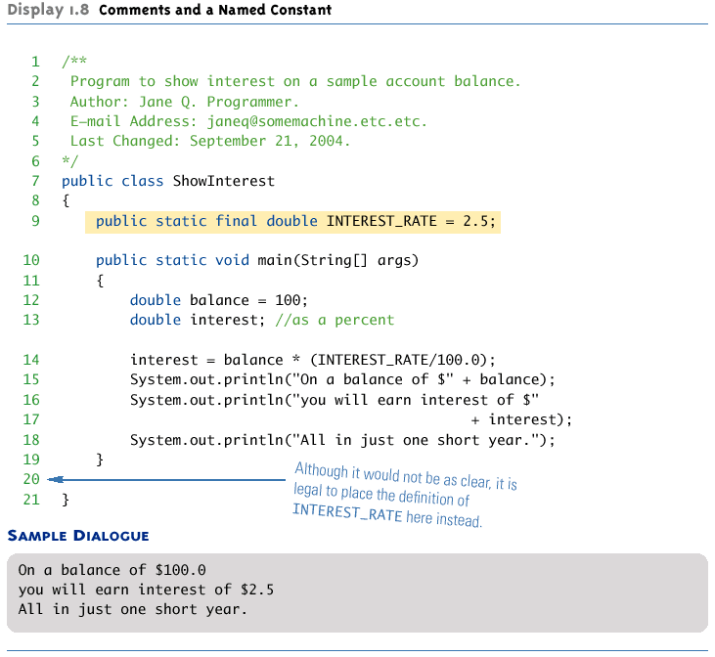
Comments and a Named Constant
Copyright © 2010 Pearson Addison-Wesley. All rights reserved.
1-<number>

